Slide 1
NMR introduction: Quantum mechanics meets NMR
4th NMR Meets Biology Meeting
Konstantin Ivanov (Novosibirsk, Russia)
Part 1: NMR interactions
Part 2: Basics of spin dynamics
Khajuraho, India, 16-21 December 2018

Slide 2
Outline, part 1
Zeeman interaction
Chemical shift, chemical shift anisotropy;
Spin-spin interactions: dipolar coupling and scalar coupling;
Quadrupolar interaction.

Slide 3
Spin Hamiltonian
In quantum mechanics, we need to solve the Schrödinger equation for ψ or the Liouville-von Neumann equation for ρ
Generally, we need to write down and solve the following equation:
Here ψ is the w.f. of the entire system of electrons and nuclei. This equation is virtually impossible to solve.
Solution is provided by the spin Hamiltonian hypothesis:
We limit ourselves to only nuclear spin degrees of freedom, which are decoupled from other degrees of freedom.
Key question: how can we write down the spin Hamiltonian?
In most cases, one can introduce s.H. by separating timescales of electronic and nuclear motions and by keeping in mind that nuclear spin energies are small

Slide 4
Nuclear spin interactions
Interactions
Electric
Magnetic
Quadrupolar coupling, I>½
Zeeman interaction
Spin-spin interactions, J and D

Slide 5
Angular momentum and magnetic moment
In NMR we deal with spin magnetism. What is ‘spin’?
Charged nucleus (or electron) is spinning:
there is angular momentum (spin) and magnetic moment
attention: this is a simple view, which is not (entirely) correct
The electric current for a charged
particle moving around
The magnetic moment is
q
So, μ is proportional to a.m.; when a.m. is measured in ħ units
Is it entirely correct? The idea of a very small particle turning around is anyway a simplification…

Slide 6
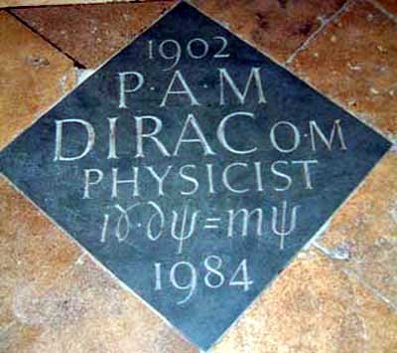
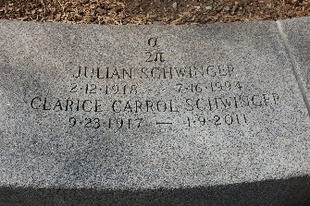
Angular momentum and magnetic moment
q
So, μ is proportional to a.m.; when a.m. is measured in ħ units
Quantum mechanics: this is not entirely correct
We are wrong by the g-factor! g=2 for an elementary spin-½ particle (Dirac)
How about nuclear spins?
Proton g-factor is significantly larger than 2, neutron has magnetic moment
Relation between µ and I:
γ-ratio, gyromagnetic ratio

Slide 7
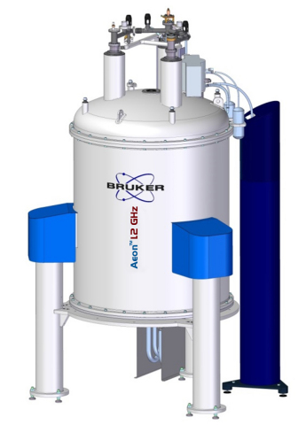
Zeeman interaction
Particles with I≠0 have magnetic moment and interact with external magnetic fields. The energy associated with this interaction is equal to
The field can be static (along Z) or oscillating (along X/Y)
Motion in the static field: precession of µ at the frequency ω=|γ|B
Direction of precession depends on the sign of γ.
Motion in the oscillating transverse field: spin nutation once the resonance condition is fulfilled
The resonance frequency is determined by γ
Nucleus | Net Spin | (MHz/T) | NMR freq. @ 7 Tesla (MHz) | Natl. abundance (%)
¹H | 1/2 | 42.58 | 300 | 99.98
²H | 1 | 6.54 | 46 | 0.0115
¹³C | 1/2 | 10.71 | 75 | 1.1
¹⁵N | 1 | -4.3 | 30 | 0.37
¹⁹F | 1/2 | 40.08 | 282 | 100
³¹P | 1/2 | 17.25 | 121 | 100

Slide 8
Chemical shift
electrons
(shielding)
The simple expression is (completely) correct only for a nucleus in vacuum
In molecules, electrons change the local field experienced by nuclei: Zeeman interaction is modified
This is a two-stage process:
the external B₀ field induces currents in the electronic cloud
when the electrons move, they change the magnetic field at the location of the nucleus: B₀→B_{loc}=B₀+B_{ind}
The B_{ind} field is opposite in direction to B₀: the field is “shielded” by the electrons
There are two contributions to B_{ind} (having similar magnitude but opposite signs)
circulation of electrons in the ground state (diamagnetic)
involvement of electrons in the excited state (paramagnetic)
B₀
B_{ind}
nucleus

Slide 9
Chemical shift
B₀
The induced field is always proportional to the B₀ field, therefore
The resonance frequency becomes
The new parameter, δ (or σ), is called chemical shift: its precise value depends on the chemical environment of a nucleus (electron density, electronegativity of neighboring atoms, etc.).
Thus, chemical shift is a very important source of information about molecular structure
Chemical shift referencing:
Chemical shift is usually small, so it is measured in ppm’s of ω_{ref}
Protons have a spread of δ-values of several ppm; other nuclei have a much wide range of δ-values
B_{ind}
ω_{ref} is the NMR frequency of a standard reference compound (e.g., TMS)

Slide 10
Chemical shift tensor
For a shape asymmetric molecule, the B_{ind} and B_{loc} fields depend on the orientation
The precise value of B_{ind} depends on the orientation. Mathematically, this effect can be described by introducing the chemical shift tensor
Hence, the induced field becomes:
At high-fields, only the z-component is of importance
B₀
B₀
B_{ind}
The B_{ind} value is different in these two cases
B_{ind}

Slide 11
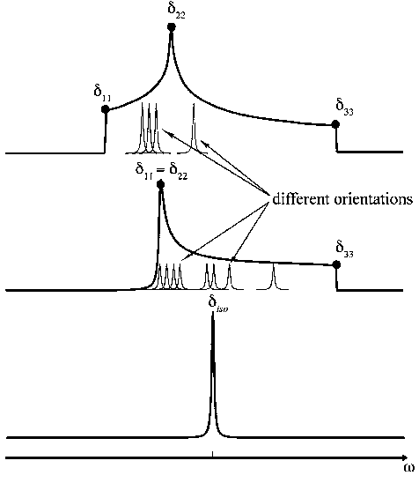
Chemical shift tensor, continued
The position of the NMR line is given by δ_{zz}, which is different for different orientations of the molecule
In isotropic liquids, the result is simple: fast reorientation of the molecule gives rise to the symmetric CSA tensor. Hence, the isotropic chem. shift is
In solids, for different orientations we obtain a different result.
There are special directions, for which B_{ind} is parallel to B₀: principal axes of the δ-tensor. In the principal axes system (PAS) the tensor is diagonal:
When the B₀ field is parallel to X,Y,Z of the PAS, the line position is given by δ_{xx}, δ_{yy}, δ_{zz}.

Slide 12
Spin-spin coupling
Two nuclei are two magnetic moments, which interact
There are two contributions:
dipole-dipole interaction, goes through spaces, complete analogue of the classical DDI
scalar coupling, bonding electrons are involved quantum effects
Both contributions can be included in the spin Hamiltonian
The DDI constant depends on the distance between the spins
DDI depends on molecular orientation, given by the vector connecting the spins, J-coupling is isotropic

Slide 13
Dipole-dipole coupling
The DDI Hamiltonian can be written by using tensors:
The D-tensor is a symmetric traceless tensor
For this reason, on average DDI is zero: in isotropic liquids DDI does not change the position of NMR lines
In solids, DDI gives rise to broad lines as it vanishes only at the magic angle.
In high-field approximation (Zeeman term dominates)
The coupling strength is
Some numbers: proton-proton DDI at 1.5 Å is about 35 kHz
DDI scales with γ_{i}×γ_{k} and decays as 1/r³
Z||B₀
Homonuclear case
Heteronuclear case

Slide 14
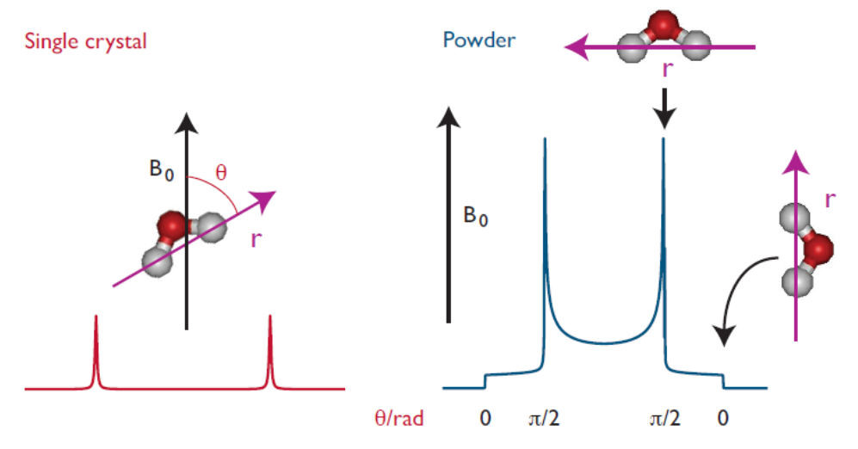
Dipole-dipole coupling
Spectral manifestation of DDI:
- In single crystals, DDI gives rise to splitting of the NMR lines. The splitting is given by d_{ik} at a specific Θ_{ik} angle.
- In a powder, the splitting is different for different Θ_{ik} angles (ranging from 0 to π). To calculate the spectrum we need to calculate the splitting for each orientation and weight it with sinΘ.
In some systems, e.g., liquid crystals, partial averaging of DDI takes place. Instead of DDI we deal with RDC (Residual Dipolar Coupling)
Such a pattern is termed Pake doublet

Slide 15
Scalar coupling
Indirect coupling, which goes through bonding electrons
Physical origin:
nuclear spins interact with the electrons (hyperfine coupling)
electrons become partly ‘unpaired’ and
start interacting with the other nucleus by creating a small magnetic field
As a result, a nuclear spin-spin coupling emerges
Typically, J-coupling is much smaller than DDI:
For protons the largest coupling is usually the geminal coupling ²J (15-20 Hz, negative), vicinal coupling ³J is smaller (7 Hz, positive).
For neighboring atoms in the molecule J-couplings are bigger: about 135 Hz for ¹³C-H, about 50 Hz for ¹³C-¹³C
J-couplings are not averaged out by motions. In liquid-state NMR they determine splitting of NMR multiplets
vicinal
H1
H3
geminal
C
C
H2

Slide 16
How can we read NMR spectra?
For simplicity, here we discuss only liquid-state NMR. We also ignore any details of the spin dynamics and use selection rules ΔI_{z}=±1 for NMR transitions (single spin flips/flops)
Hence, we try to construct “stick-spectra”. Interactions, which matter, are chemical shifts and J-couplings.
Algorithm:
(1) Different nuclei give signals at very different frequencies because of the large differences in γ’s ⇒ in experiment we detect separately NMR signals from protons, or carbons, or nitrogens (etc.);
(2) Different nuclei of the same kind (e.g., protons) give NMR signals not exactly at the same frequency due to chemical shifts;
(3) Lines corresponding to certain nuclei are split due to the presence of other spins ½.
Having this strategy, we can draw NMR spectra

Slide 17
Simplifications
(1) Spins will be considered weakly coupled: for each pair of non-equivalents spins difference in Zeeman interactions, ω_{i}–ω_{j}, is much larger than the corresponding coupling J_{ij};
(2) Quantum mechanics (perturbation theory) tells us that we can leave only J_{ij}I_{iz}I_{jz} terms (secular terms);
(3) Equivalent spins do not interact with each other (in fact, they do, but these couplings cannot be detected).
What do we call equivalent spins:
Same chemical shifts;
Identical couplings to all other nuclei.

Slide 18
NMR spectrum of two weakly coupled spins
Without interaction
With interaction
β_{A}β_{B}
β_{A}β_{B}
4
ν_{A}/2+ν_{B}/2
4
ν_{A}/2+ν_{B}/2+J/4
3
β_{A}α_{B}
ν_{A}/2–ν_{B}/2
3
β_{A}α_{B}
ν_{A}/2–ν_{B}/2–J/4
–ν_{A}/2+ν_{B}/2
–ν_{A}/2+ν_{B}/2–J/4
2
α_{A}β_{B}
2
α_{A}β_{B}
1
–ν_{A}/2–ν_{B}/2
1
–ν_{A}/2–ν_{B}/2+J/4
α_{A}α_{B}
α_{A}α_{B}
NMR
NMR
4 transitions from rules ΔI_{z}=±1; 2 lines because transitions overlap
4 transitions from rules ΔI_{z}=±1; 4 lines because transitions do not overlap

Slide 19
What to do for a larget number of spins?
Each spin ½ splits NMR line in two lines; their intensities are 2 times lower
Coupling to a group of equivalent spins
No other spins
+1 spin ½
+2 spins ½
To be continued…
J
J
J′
Relative line intensities in the multiplet
Pascal’s triangle
1
1 1
1 2 1
1 3 3 1
N=0 1 2 3

Slide 20
Examples: CH₃OH and CH₃CH₂OH
3
3
12
12
NMR spectrum
of methanol
1
1
OH
CH₃
NMR spectrum
of ethanol
OH
CH₂
CH₃
Intensity of all lines in the multiplet is proportional to the number of spins in the group
Splitting is the same for both spins (same J is operative)
Distribution of the intensities is given by Pascal’s triangle rules

Slide 21
Quadrupolar coupling
Q.C. is an electric interaction, which is nonetheless included in the nuclear spin Hamiltonian
Origin of Q.C.
A nucleus has electric charges, which interact with external E-fields
Positive electric charge can be distributed non-uniformly
The charge distribution can be decomposed into multipole components (charge q, dipole moment d, quadrupolar moment Q, etc.); the same is true for the field: the potential is given by the potential V₀ at the nucleus, its gradient V₁, gradient of the gradient V₂, etc.
The energy of interaction is the sum of the following components:
E₀, energy of q in potential V₀
E₁, energy of d in potential V₁
E₂, energy of Q in potential V₂
continued...
Important: nuclei have d=0! Shape of the nucleus, i.e. charge distribution, is related to the value of its spin I: Q=0 for I=0,½. Spin comes into play!

Slide 22
Quadrupolar coupling
Q.C. is of importance for nuclei with I>½
It comes from interaction of Q with the electric field gradient at the nucleus
E-field gradient is a tensor, V-tensor:
As any other tensor, it has a PAS, in this frame, simply
The interaction of the E-field gradient with Q can be expressed via I
If H_{Q} is much smaller than the Zeeman terms, we can use perturbation theory. First-order Q.C. is
Second-order Q.C. is about

Slide 23
Quadrupolar coupling
From the expression
we can see that
Q.C. vanishes for I=0 and I=½
Orientation dependence is given by V_{zz}, which is the zz-component of the V-tensor.
The result is different for a single crystal and for a powder sample
The result is also different for half-integer and for integer I
If we include the second-order terms into consideration the result becomes even more complex.
In some cases, when Q is very large, we have to consider this contribution as well.

Slide 24
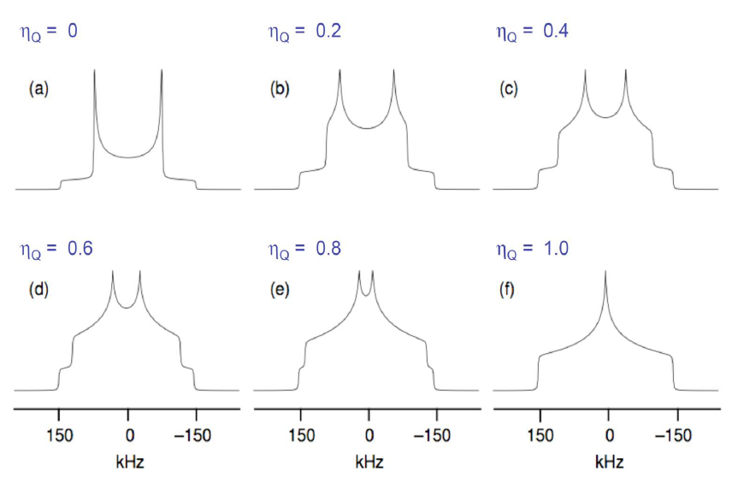
Quadrupolar coupling, integer spin
Single crystal:
Just two lines
Powder spectra
Each component is broadened, since the splitting is different for different orientations
For axially-symmetric V-tensor Pake pattern is obtained
Otherwise, the pattern is more complex

Slide 25
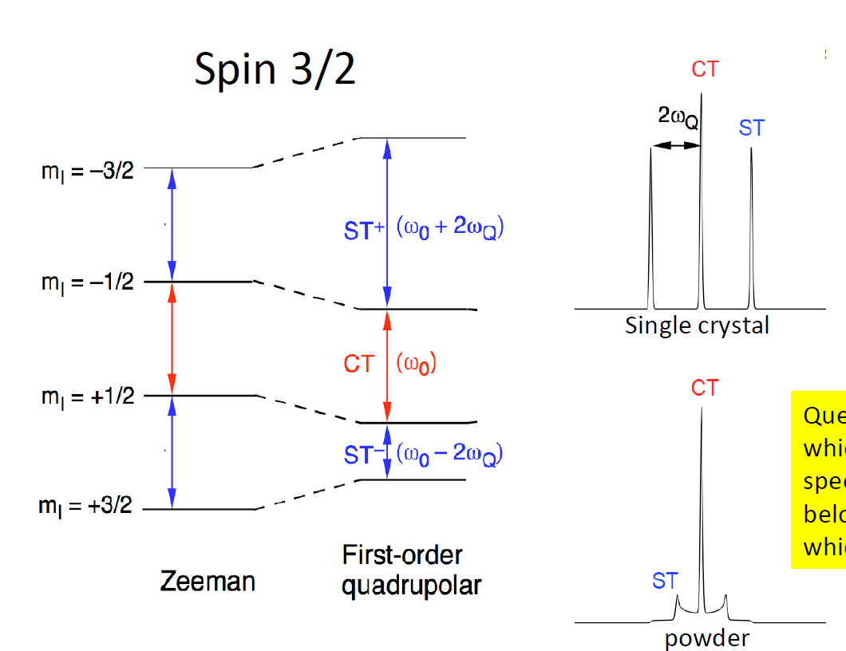
Quadrupolar coupling, half-integer spin
Single crystal:
Just two lines
Powder spectra
In a powder, the central line remain narrow
Other lines get broadened, like in the previous example

Slide 26
Summary, part 1
Key NMR interactions are introduced;
We may also need to mention spin-rotation interaction, which is usually (not always) not that important for NMR;
Spectral manifestations of the interactions are discussed.

Slide 27
Outline, part 2
Notion of spin;
Spin ensembles: density matrix;
Density matrix description of NMR experiments;
Some examples.

Slide 28
Spin: some history
Zeeman effect: lines split in the presence of magnetic field
Normal Zeeman effect (theory by Lorentz): splitting into three components
Atom is a harmonic oscillator, its frequency is
Problem: anomalous Zeeman effect also exists (met even more often)!
A colleague who met me [Pauli] strolling rather aimlessly in the beautiful streets of Copenhagen said to me in a friendly manner, “You look very unhappy”; whereupon I answered fiercely, “How can one look happy when he is thinking about the anomalous Zeeman effect?”
k┴Z
In the presence
of B₀||Z
k||Z
σ⁺
σ–
σ
π
σ

Slide 29
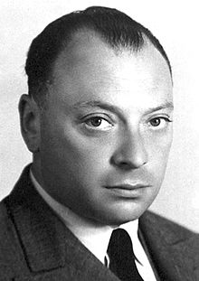
Spin: some history
Pauli also tried to solve the problem concerning the number of electrons in each electron shell
For a given n we have l from 0 to (n – 1), l_{z} from – l to l n² states
In reality there are 2n² electrons in each shell. Why 2 electrons for n=1, 8 electrons for n=2, 18 electrons for n=3?
Pauli’s answer:
(1) there is one more quantum number, which
can take only two possible values (Zweideutigkeit)
(2) there cannot be two electrons in the same state, i.e., with
all q. numbers being the same – exclusion principle
Problem: nice answer, which leads to even harder questions: Why is it so? What is the last quantum number? To what degree of freedom does it correspond?

Slide 30
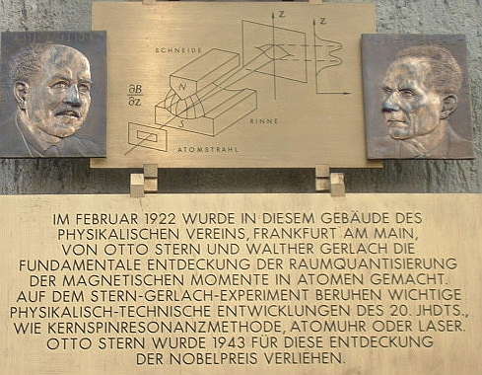
Spin: some history
Uhlenbeck and Goudsmit: particles have “spin”, corresponding to rotation of a particle spinning around its own axis
Spin of the electron is ½: two states +½=“spin-up” and –½=“spin-down”
This is not fully consistent from what people knew before. However, this is appropriate because spin is a quantum notion (we do not know why!)
(S + L) can to explain the anomalous Zeeman effect (Pauli can be happy ☺)
Stern-Gerlach experiment
The beam of atoms is deflected by inhomogeneous field
Reason: intrinsic magnetic moment (spin) of particles
The distribution of the μ-vector is not continuous!
Spin is quantized!!!

Slide 31
Spin
Spin of a particle is its intrinsic angular momentum (as if the particle rotates). Honestly, nobody knows where spin comes from.
Spin is a very fundamental concept, which also affects the symmetry of the w.f. of a system of identical particles. Example: Pauli principle.
Spin is a quantum notion: it vanishes if we tend ħ → 0!
Spin operators are introduced in the same way as those for the angular momentum:
eigen-states are ; S²=S(S+1), S_{z} varies from – S to S.
commutation rules are
An important difference from angular momentum: spin can be half-integer
Spin operators are (2S+1)*(2S+1) matrices
For S=1/2 such matrices are related to the Pauli matrices

Slide 32
Spin ½
Basis
Spin operator can be written as
Useful relations of the Pauli matrices:
Every 2*2 hermitian matrix is a linear combination of the unity matrix and the Pauli matrices
Rotations (same results as for L):
for an infinitely small rotation
for a rotation by an arbitrary angle (rotation by 2π changes the sign of ψ!)

Slide 33
Spin ½: rotations
Generally, the rotation operator is
Explicitly, rotations about X,Y,Z
Euler rotations
transition from any
reference frame to a new
frame can be achieved
by three elemental rotations
We go from an old x,y,z to new x,y,z : zyz-rotation by α,β,γ
The rotation operator is

Slide 34
Spin evolution
We can write the Schrödinger equation for the spin w.f.
Here the Hamiltonian (operator, which stands for the energy) is a matrix, which acts on the spin w.f.; it includes magnetic interactions
For instance, interaction with external field, spin-spin interactions, etc.
To solve the time-dependent solution we first solve the eigen-problem
Then the solution is
Physical observables are:

Slide 35
Spin Hamiltonian
To calculate what happens to the spin system we need to know the Hamiltonian
Spins are little magnets, μ is proportional to S
Spin interactions coming from μ
Zeeman interaction
in molecules this interaction is modified due to shielding of the external field (chemical shift). Generally, C.S. is a tensor
Interaction with time-dependent RF-fields can be treated in the same way
Spin-spin interaction
scalar dipolar
Quadrupolar interaction

Slide 36
Simple example: spin ½ particle in an external field
The Hamiltonian
Let us calculate the “spin polarization” vector:
General expression for the w.f.:
Calculation result:
What happens to the P-vector? Example:
The time-dependent S.e. gives the following result (Larmor precession):

Slide 37
Ensemble of spins
This is not the end of the story: the w.f. description is often not sufficient
Example: N₁ spins in the α-state and N₂ spins in the β-state
What is the P-vector in this case?
When spin ½ has a w.f. |P|=1: the spin ensemble does not have a w.f.!
Similar problems arise when a system contains two subsystems: there might be a total w.f. existing, but (sometimes) no w.f. of a subsystem
What should we do if the w.f. does not exist? Can we still evaluate expectation values of interest and describe experiments?

Slide 38
Density matrix
If we have two sub-ensembles, we calculate expectation values for each realization and then perform averaging
From the mathematical point of view:
The new operator is called “density operator” or “density matrix”
The problem is solved: we can calculate expectation values!
Questions:
Properties of the d.m.? Time-dependence of d.m.?

Slide 39
Properties of the density matrix
Physical meaning of the elements:
Diagonal elements are populations
Off-diagonal elements are coherences ρ_{mn} (explained later)
The trace of d.m. is equal to 1
The d.m. is a hermitian matrix: (N ² – 1) independent parameters
When can we still use the w.f. description?
When the w.f. is existing (pure state), we obtain
When this relation does not hold (mixed state), we must not (!) use the w.f. description. Example: ensemble of spins-1/2 at equilibrium
In this case ρ²=ρ does not hold

Slide 40
Density matrix of a spin-½ particle
D.m. of a spin ½ particle
The polarization vector components are
Rewriting the d.m.:
The d.m. is expressed via the P-vector and the Pauli matrices
Longitudinal M = Δ(population); transverse M = coherence
Phase of the coherence: direction in the {x,y}-plane
β
α
β
α
β
α
β
α

Slide 41
Density matrix of a spin-½ particle
D.m. of a spin ½ particle
The polarization vector components are
Rewriting the d.m.:
We can use the operator basis (each matrix is like a basis ket)
The d.m. is a vector in this basis:
It is easy to obtain the equation of motion (comes later)

Slide 42
Two or more spins ½
The d.m. for two spins can be expressed in terms of product operators
Each product operator is now a 4*4 matrix; likewise, the Hamiltonian is a 4*4 matrix and it is expressed via the product operators
What is the direct product (Kronecker product)?
Example with 2 spins:
Other operators can be constructed in the same way. More spins: use direct products of spin operators

Slide 43
Two spins ½
Relation between populations/coherences and d.m. elements
SQCs are given by S_{x}, S_{y}, S_{x}I_{z}, S_{y}I_{z}, I_{x}, I_{y}, S_{z}I_{x}, S_{z}I_{y}
DQCs and ZQCs are given by combinations of S_{x}I_{x}, S_{y}I_{y}, S_{x}I_{y}, S_{y}I_{x}
We can directly measure only transverse magnetization S_{x}, S_{y}, I_{x}, I_{y}
Other operators cannot be observed directly, but they affect the signal
Coherence order for ρ_{mn}:
Energy level diagram
Density matrix
ββ
 | αα | αβ | βα | ββ
αα | p_{αα} | SQC | SQC | DQC
αβ | SQC | p_{αβ} | ZQC | SQC
βα | SQC | ZQC | p_{βα} | SQC
ββ | DQC | SQC | SQC | p_{ββ}
αβ
βα
αα

Slide 44
How does the d.m. evolve?
The S.e. in the bra and ket representations is
The equation for the d.m. is as follows:
Liouville-von Neumann equation
The solution is simple for a time-independent Hamiltonian:
For a time-dependent Hamiltonian we solve the equation numerically in small time steps or use some tricks
The LvN equation is similar to that for the time-derivative of an operator in the Heisenberg representation. However, the sign is “–” and the meaning is different: in the Heisenberg representation the d.m. and w.f are constant

Slide 45
Time-dependence of the d.m.
The LvN equation is simple in the eigen-basis of the Hamiltonian
The solution is also simple:
Eigen-state populations do not evolve (a quantum system stays forever in an eigen-state); off-diagonal elements oscillate at the ω_{mn} frequency (coherence).
Oscillatory evolution comes about when the initial state is a coherent superposition of eigen-states.
Expectation value of an operator evolves as follows:
coherences result in “quantum beats”

Slide 46
Precession of spins ½
The d.m. is
Likewise, the Hamiltonian is:
So, we can define the P-vector and the field-vector
Substitution to the LvN equation:
The commutator term is:
Finally we obtain precession of the P-vector:
Furthermore, all 2-level systems behave this way: precession of the effective spin in an external field in 3D. The prec. frequency is ω_{pr}=|H|/ħ

Slide 47
Magnetic resonance
Let us consider also the B₁-field (circular polarization)
The Hamiltonian is
The LvN equation reads
We can define the d.m. in the rotating frame (interaction representation)
Equation for the new d.m.
The result is (still) precession in an effective field

Slide 48
QM description of NMR experiments
We (usually) start with thermally polarized spins:
The same is true in the rotating frame because the d.m. commutes with the rotation operator; the unity operator can be dropped off.
The d.m. evolves under the action of a time-dependent Hamiltonian (pulses, free evolution, MAS)
Solution methods: split the time-axis into small intervals δt, where H≈const
Looks complex, but the idea is simple: each evolution period leads to two multiplications (at the left and at the right)
In many cases the solution can only be done numerically
When the Hamiltonian is changed in a periodic way, there are some tricks available (AHT, Floquet theory)

Slide 49
RF-pulses
What happens to the d.m. (magnetization) when we apply a pulse?
The w.f. and d.m. after the pulse
The action of a strong pulse is equivalent to a rotation (we assume that only the B₁-term is relevant)
A π/2-pulse generates a coherence, a π-pulse inverts the populations
the phase is ϕ_{p}
the flip angle is φ=ω₁τ_{p}
τ_{p}
ω₁
t t+τ_{p}

Slide 50
“Sandwich relationships”
Is there a simple way to calculate the effect of pulses?
Three cyclically commuting operators:
Example:
The following relation is then true:
A, B, C are like the axis of our 3D-space; we “rotate” B “around” A by the angle θ. Cyclic permutations provide two more relations
Of course, these rules apply to the spin operators
RF-pulses give x and y-rotations. Free precession gives a z-rotation by a time-dependent angle ωt
See M. H. Levitt, “Spin Dynamics”, cyclic commutation

Slide 51
Phase of the pulse
Different phases
x-pulse, ϕ_{p}=0 y-pulse, ϕ_{p}=π/2
–x-pulse, ϕ_{p}=π –y-pulse, ϕ_{p}=2π/2
Pulse of a general phase is a combination of three rotations
Rotation about z turns the {x,y} axes; then a pulse is turning the spins around the new x; finally, we return to the original frame.
Free precession is just a z-rotation
z
z
y
x
z
z
y
x

Slide 52
Single-pulse NMR experiment
Initial spin order is S_{z}
A pulse generates transverse magnetization
Free precession changes the d.m.
We can detect the FID and obtain the spectrum by doing the Fourier transform
Generally, the FID is
If the receiver phase is 0 we obtain a positive Lorentzian (after adding T₂)
when ϕ_{rec}=π we obtain a negative line
when ϕ_{rec}=±π/2 we obtain a dispersive line

Slide 53
More complex NMR experiments
The S_{x}, S_{y}, S_{z} are not the only operators, which satisfy the cyclic commutation relation
Other operators of this kind:
The operator S_{z}I_{z} is often present in the Hamiltonian (secular interaction)
We can immediately obtain what different interactions do
Effect of the chemical shift:
S_{x} ⇒ S_{x}cos(ω_{a}t)+S_{y}sin(ω_{a}t)
Effect of J-coupling with spin I:
S_{x} ⇒ S_{x}cos(J_{ab}t)+S_{y}I_{z}sin(J_{ab}t)
y
y
β
α
β
α
x
x
x-component changes in the usual way; y-component is given by
the population difference of the α- and β-states of spin I, which is I_{z}

Slide 54
Key to simple experiments (from Shimon Vega)

Slide 55
Example: COSY experiment
π/2 π/2
How does it work?
S_{z} ⇒ –S_{x} ⇒ S_{x} ⇒ S_{x} ⇒ – S_{y}
x-magnetization stays on spin a
The efficiency of this pathway is
sin(ω_{a}t₁)cos(J_{ab}t₁)sin(ω_{a}t₂)cos(J_{ab}t₂)
A diagonal peak will appear in the COSY-spectrum
π/2_{x} t₁ π/2_{x} t₂
t₁
t₂
COSY: J-coupling (through
bond connectivities of neigh-
boring atoms, max. ~3 bonds)
Gain is two-fold:
(1) Spectral resolution is increased because peaks become resolved in 2D;
(2) Knowledge on additional coherence pathways can be obtained.

Slide 56
Example: COSY experiment
π/2 π/2
How does it work?
S_{z} ⇒ –S_{y} ⇒ 2S_{y}I_{z} ⇒ 2S_{z}I_{x} ⇒ –I_{y}
x-magnetization has gone from spin a to spin b
The efficiency of transfer is
sin(ω_{a}t₁)sin(J_{ab}t₁) sin(ω_{b}t₂)sin(J_{ab}t₂)
A cross-peak will appear in the COSY-spectrum
The cross-peak is the direct evidence for J-coupling
π/2_{x} J_{ab} π/2_{x} J_{ab}
t₁
t₂
COSY: J-coupling (through
bond connectivities of neigh-
boring atoms, max. ~3 bonds)
Gain is two-fold:
(1) Spectral resolution is increased because peaks become resolved in 2D;
(2) Knowledge on additional coherence pathways can be obtained.

Slide 57
Example: COSY experiment
π/2 π/2
Result for more than 2 spins
t₁
t₂
ω₂→
COSY: J-coupling (through
bond connectivities of neigh-
boring atoms, max. ~3 bonds)
Ω₁ Ω₂ Ω₃ Ω₄
ω₁→
When the spins are scalar coupled cross-peak will appear
In 2D peaks, which overlap in 1D-spectrum, become resolved

Slide 58
Summary, part 2
Density matrix description of spin ensembles
QM description of NMR experiments
QM in action: some NMR examples

Slide 59
Example: INEPT experiment
Populations at equilibrium
ββ
NMR signal is proportional to the γ-ratio
4 times higher signals for protons than for ¹³C; even 10 higher than for ¹⁵N
Possible improvement is polarization transfer ¹H→X-spin
NOE is not (always) the best solution: coherent mechanism and proper pulsing work better
INEPT=Insensitive Nuclei Enhanced by Polarization Transfer
¹H
βα
¹³C
αβ
αα
¹H¹³C
ββ
βα
¹³C
^{selective}
^{inversion}
αβ
αα
¹H¹³C

Slide 60
INEPT experiment: explanation
π/2 π π/2
τ
τ
y
¹H
X
β
α
π/2 π π/2
t₂
x
All spins are along x
INEPT: transferring polarization from proton to X-nucleus

Slide 61
INEPT experiment: explanation
π/2 π π/2
τ
τ
y
¹H
X
β
α
π/2 π π/2
t₂
x
For τ =1/4J the angle between spins is 90 degrees
INEPT: transferring polarization from proton to X-nucleus

Slide 62
INEPT experiment: explanation
π/2 π π/2
τ
τ
α
β
y
¹H
X
π/2 π π/2
t₂
x
Components are flip by protons pulse
Their colors are exchanged by X-nucleus pulse
INEPT: transferring polarization from proton to X-nucleus

Slide 63
INEPT experiment: explanation
π/2 π π/2
τ
τ
y
¹H
X
α
β
π/2 π π/2
t₂
x
Spins are along y for τ =1/4J
The last proton pulse results in one component positive and one negative
Reminder: first both were positive
INEPT: transferring polarization from proton to X-nucleus

Slide 64
INEPT experiment: explanation
Resulting populations
Now the final pulse for X-nucleus does the detection
The gain is given by the ratio of gammas
The gain can be further increased when NMR of X is detected via protons
π/2 π π/2
τ
τ
ββ
¹H
X
βα
¹³C
π/2 π π/2
^{selective}
^{inversion}
t₂
αβ
αα
¹H¹³C
INEPT: transferring polarization from proton to X-nucleus
Pulses really make possible many nice tricks with spins ☺

